Slide 1
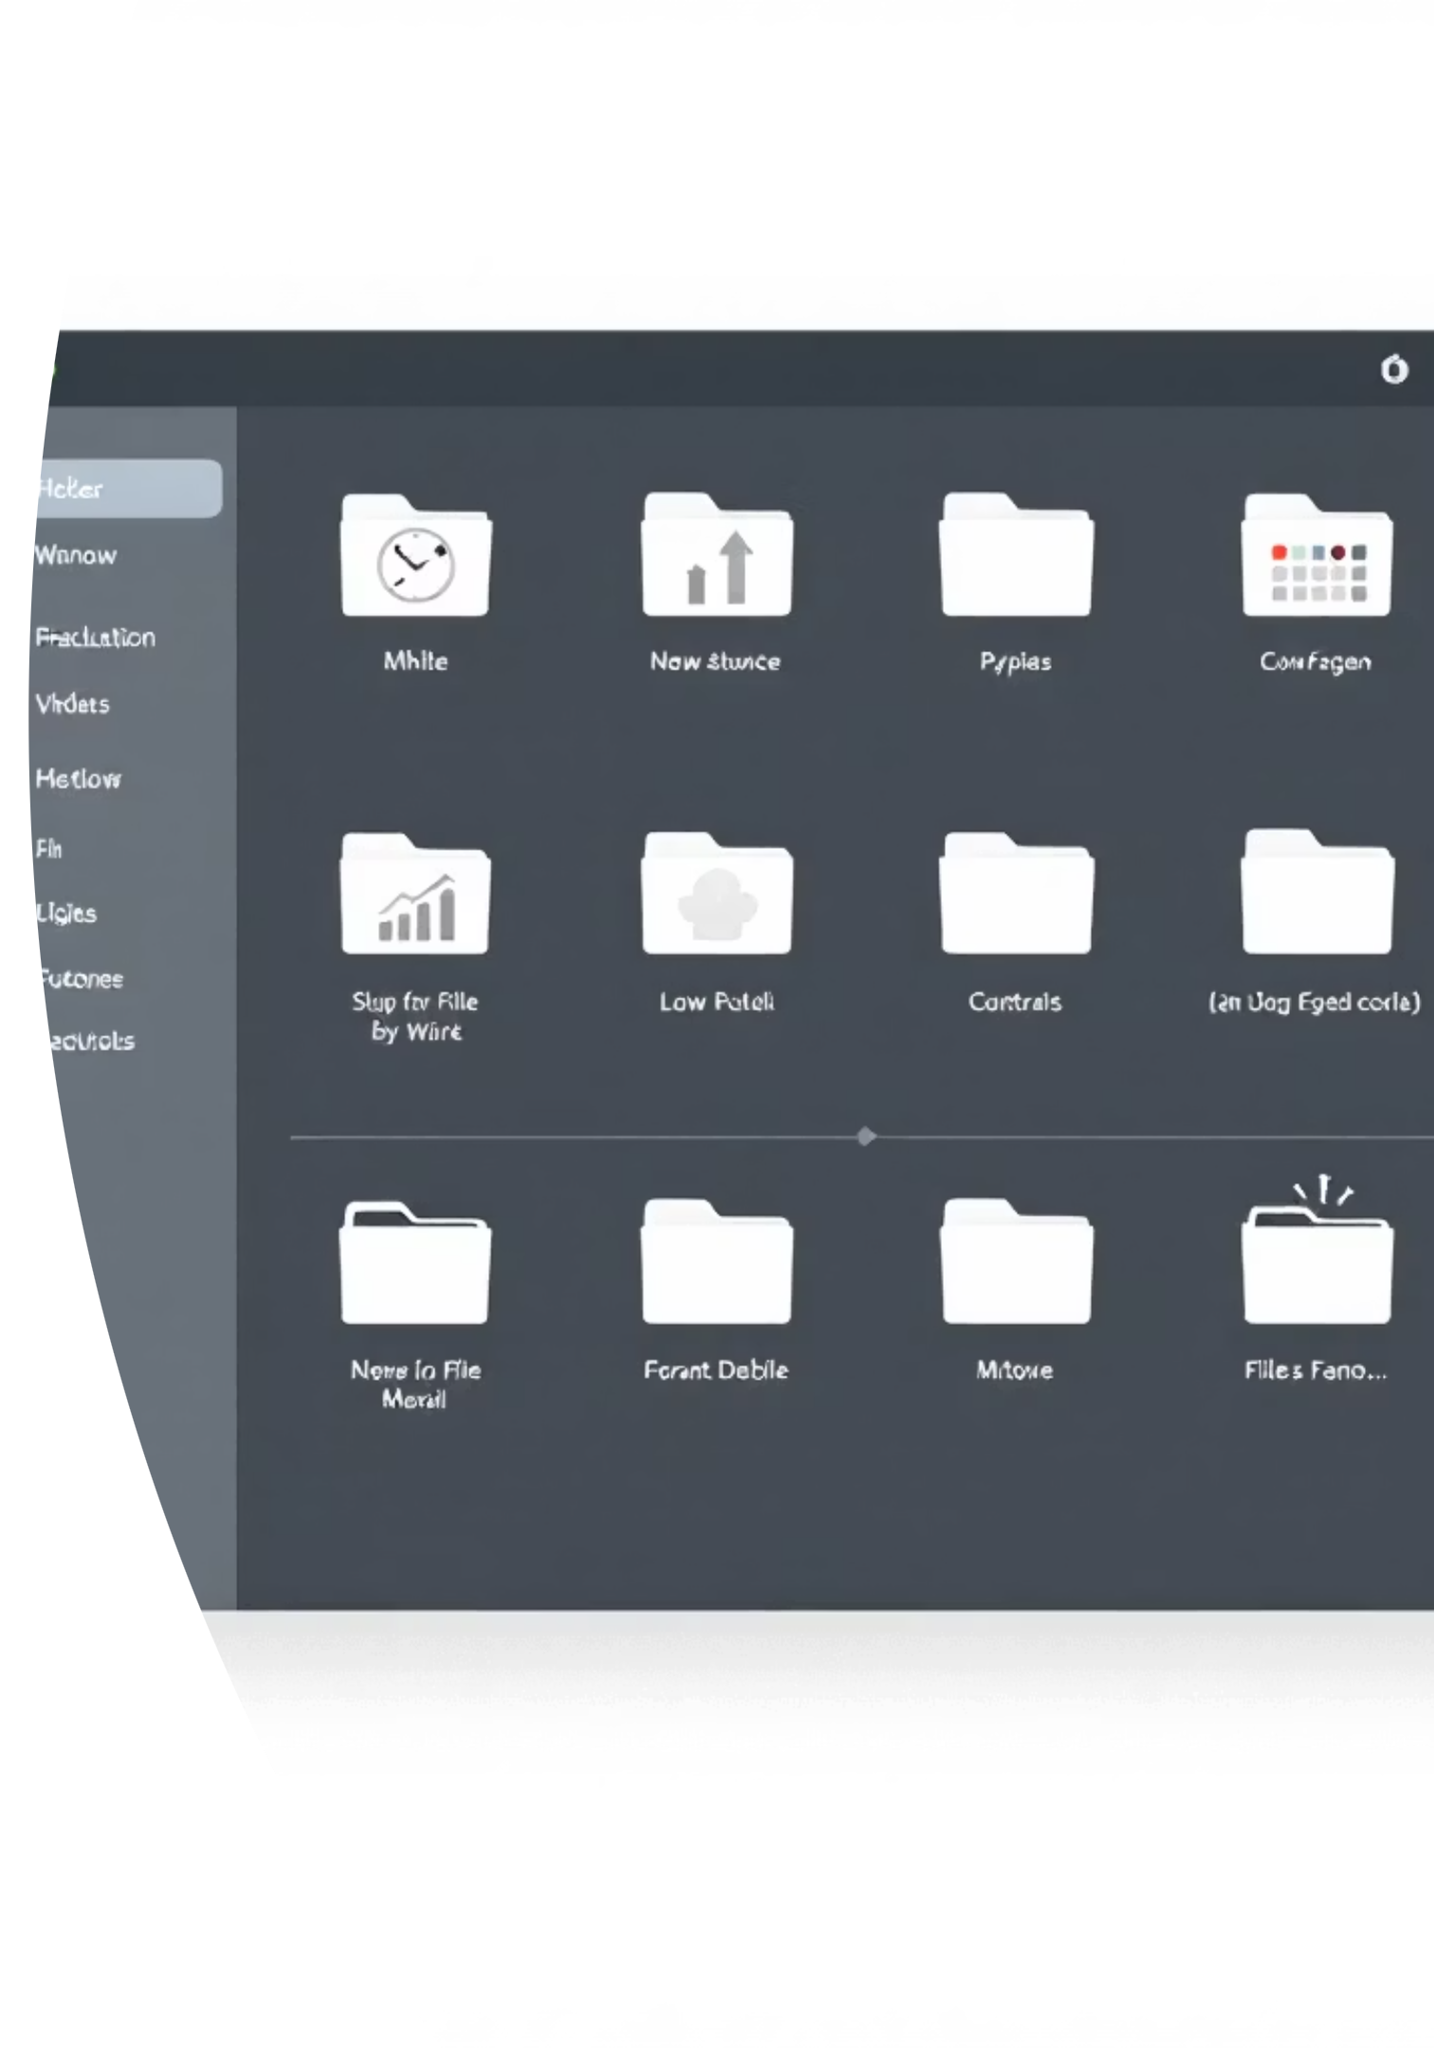
Simple File Explorer:
Cross-Platform Stable Edition
A robust and user-friendly file management tool built with Python's Tkinter.

Slide 2







Core Technologies
Python
Tkinter
The foundational language for the application logic.
Used for creating the graphical user interface (GUI).
Cross-Platform
Ensures compatibility across macOS, Windows, and Linux.

Slide 3
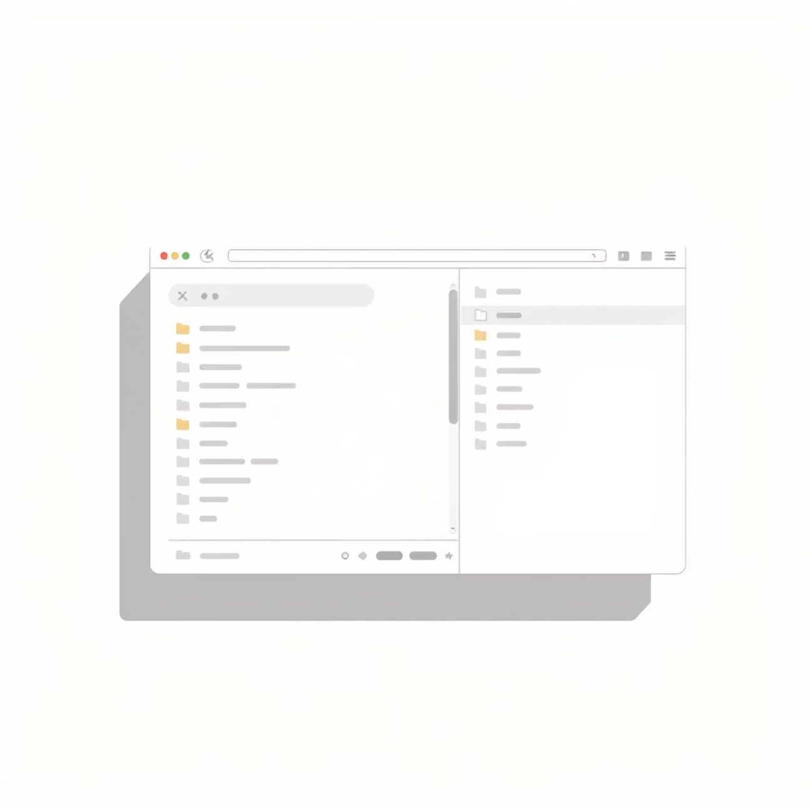
User Interface: Design & Layout
The File Explorer features a clean, intuitive design for seamless navigation.
Toolbar: Quick access to essential file operations.
Main Treeview: Displays file and folder details.
Status Bar: Provides real-time feedback on actions.

Slide 4


Key Features: Navigation
Directory Loading
Parent Navigation
Path Entry
Dynamically loads and displays contents of any specified path.
Easily move up to the parent directory with a dedicated button.
Directly input paths for quick access to specific locations.

Slide 5


File Operations: Creation & Deletion
Create Folder
Prompt for new folder names.
Delete Item
Securely remove selected files or folders with confirmation.

Slide 6




File Operations: Copy, Cut, & Paste
Copy
Copies selected items to an internal clipboard.
Cut
Prepares selected items for moving.
Paste
Transfers items to the current directory, handling name conflicts.

Slide 7


Advanced Functionality
Open with Default App
Rename Items
Launches files using the system's default application, ensuring a native user experience across platforms.
Allows users to rename files and folders, including checks for invalid names on Windows systems.

Slide 8






User Experience Enhancements
Keyboard Bindings
Double-click to open, Enter key for selected items, and Return key for path entry.
Context Menu
Right-click access to common operations like Open, Copy, Cut, Paste, Rename, and Delete.
Status Updates
Real-time feedback on actions and directory loading, enhancing user awareness.

Slide 9

Thank You!

